Slide 1
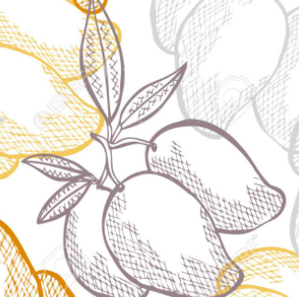




ELEGANT MANGOES DATA ANALYTICS
App acquisition recommendation report for
App TraderTM
Elegant Mangoes
Rachel Hertel, Trey Bourgeois, Tim Pearson,
Scott Boyer and Yared Gabre
Acquisition and Merger Consultants
Acquire BetterTM

Slide 2
App Acquisition Strategy
Elegant Mangoes evaluated App Store and Google Play platforms to identify the 10 best Apps for App Trader to acquire for Black Friday 2021
Key Metrics Considered
Rating
Install Count
Review Count
Shared Platform Availability
Target Demographic?
Target Genre?

Slide 3
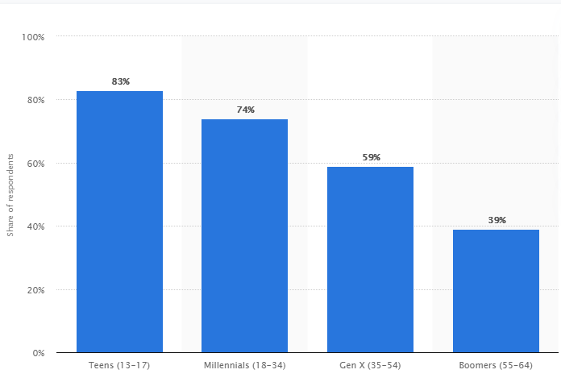
Target Demographic: Teens & Millennials
Share of mobile device owners who download apps at least once a month or more, by age group, United States
Teens and Millennials download more apps per month than any other demographic segment, with over nearly 80% of this segment downloading at least one or more apps per month
Source: Statista 2021, data as of April 2018

Slide 4
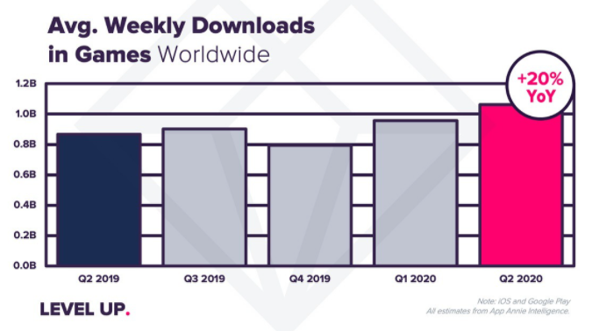
Target Genre: Games
Average global weekly game downloads, Q1 2019 – Q2 2020
Games is the hottest genre in the app market, with 20% YoY growth in weekly downloads since Q2 2019
Source: App Annie via VentureBeat
Notes:
YoY growth was 20%...but can this growth continue?

Slide 5
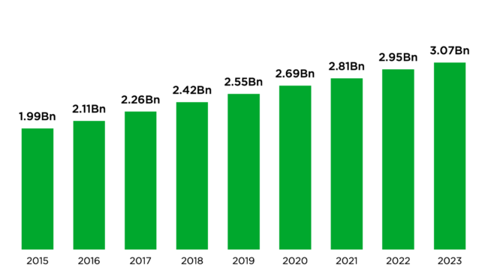
Forecasted Growth in Games
Global growth of the Games genre is expected to continue, with over 2.5 billion global users by 2023 and forecasted revenue of $200 billion
59% of mobile gamers are in the teen/millennial demographic*
2015-2023 Forecasted Growth in Global Gamers
Source: Newzoo 2020 Global Games Market Report
*Source: Statista 2020
Notes:
Transition: So clearly games is the hottest genre in our market research, but how does that translate to % share in App/Play stores?

Slide 6
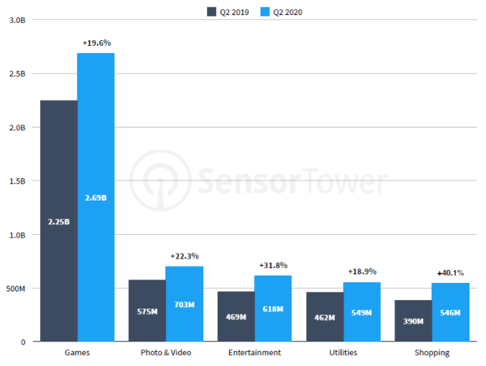
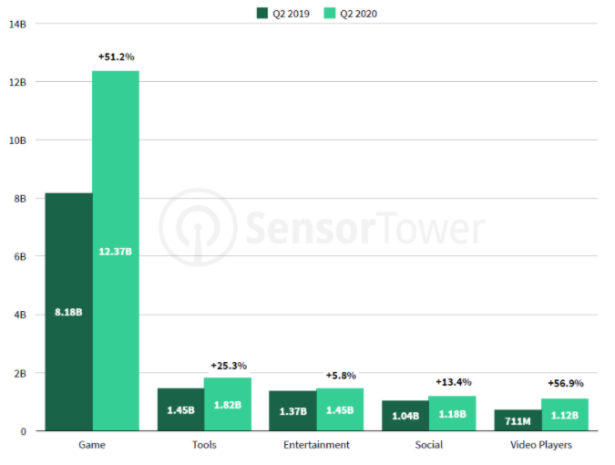
Game Genre in App Store/Google Play
Top App Store app categories. Q2, 2020
Top Google Play app categories. Q2, 2020
Source: SensorTower 2020
Source: SensorTower 2020
Dominance of Games is reflected by its highest percentage share of genres in App Store (46%) and Google Play (74%) in 2020

Slide 7
10 Apps for Black Friday
Asphalt 8: Airborne
Bullet Force
Choices: Stories You Play
Deck Heroes: Legacy
Call of Duty: Heroes
Fallout Shelter
Final Fantasy Brave Exvius
Hungry Shark Evolution
Hungry Shark World
PewDiePie's Tuber Simulator
Rating
> 4.5
Review Count
> 445K
Install Count
> 5M
Demographic and Genre
Age 13-34
Shared Platform
Alternate Recommendations
Injustice: Gods Among Us
The Simpsons: Tapped Out

Slide 8

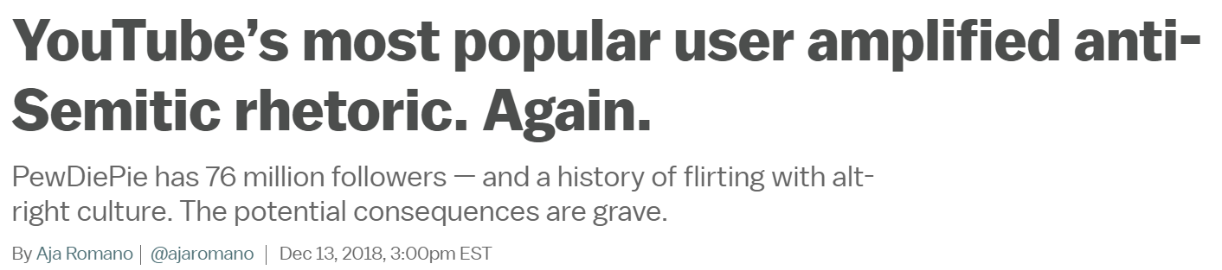

Additional Considerations: Our work with Acquire Better
Acquire Better, an acquisition and merger consultancy, has identified risk associated with PewDiePie, the inspiration for PewDiePie Simulator

Slide 9
Return on Investment
Average longevity per app: 10 years
Average Annual Income per app: $120K
Income Over 10 years per app: $1.2M
Total Projected 10-year income (all apps): $12M

Slide 10

TOP 10 APPS BLACK FRIDAY 2021 DEBUT EVENT
PewDiePie's Tuber Simulator
Deck Heroes: Legacy
Choices: Stories You Play
Final Fantasy Brave Exvius
Fallout Shelter
Earn to Die 2
Bullet Force
Hungry Shark World
Asphalt 8: Airborne
Hungry Shark Evolution
ALTERNATES
Call of Duty: Heroes
Injustice: Gods Among Us

Slide 11
Final Report
Based on the thorough analytics we did and the report we got from Acquire Better (a third-party company specialized in merger and acquisitions) we came to the conclusion and recommend the following top 10 apps to acquire
We chose these based on a few factors, starting with our initial research showing that teens were the largest demographic for downloads, and games was the most popular genre. We also considered review counts, install counts, and most importantly rating and longevity. We decided this factor carried the most weight when making our choices, because the longer the life, the more money both the developers and App Trader will earn. While we also considered selling price, our other factors filtered out anything that wasn't free. In addition to this analysis, we also took into consideration more qualitative information about these apps relating to ethics and cybersecurity. Due to PewDiePie's possible ties to white nationalism, we've offered a few alternatives

